Slide 1

Bliss basket
An online shopping platform

Slide 2
GB 30
Team Members:
Tripti Tomar 2200290140161
Vikul Dhiman 2200290140002

Slide 3
Bliss Basket
The " Bliss Basket " is a web-based platform designed to facilitate online shopping for the users This is an e-commerce website. This synopsis outlines the core features of this project.
This e-commerce website project aims to create an innovative online shopping platform that caters to the diverse needs of modern consumers. The website will offer an extensive range of products across categories such as electronics, fashion, home goods, and more, providing users with a wide selection to choose from.
One of the key features of the website will be its user-friendly interface, designed to enhance the shopping experience. Users will be able to easily browse products, add them to their cart, and securely complete their purchases using a variety of payment options. Additionally, the website will include features such as user account management, order tracking, and personalized recommendations based on user preferences.
The project will also focus on creating a responsive design that ensures the website functions seamlessly on desktops, tablets, and smartphones. This will enable users to shop conveniently from any device, enhancing accessibility and usability.

Slide 4
Project Progress
We have included the project progress presentation along with screenshots showcasing the modules that have been completed.
These screenshots provide a visual representation of the modules that are ready for review. They serve as a comprehensive overview of the progress made in the development process, highlighting the functionality and features that have been implemented thus far…

Slide 5
Completed Modules
Sign up/login page
Home page
Category selection page
Category items
Footer
Adding to cart

Slide 6
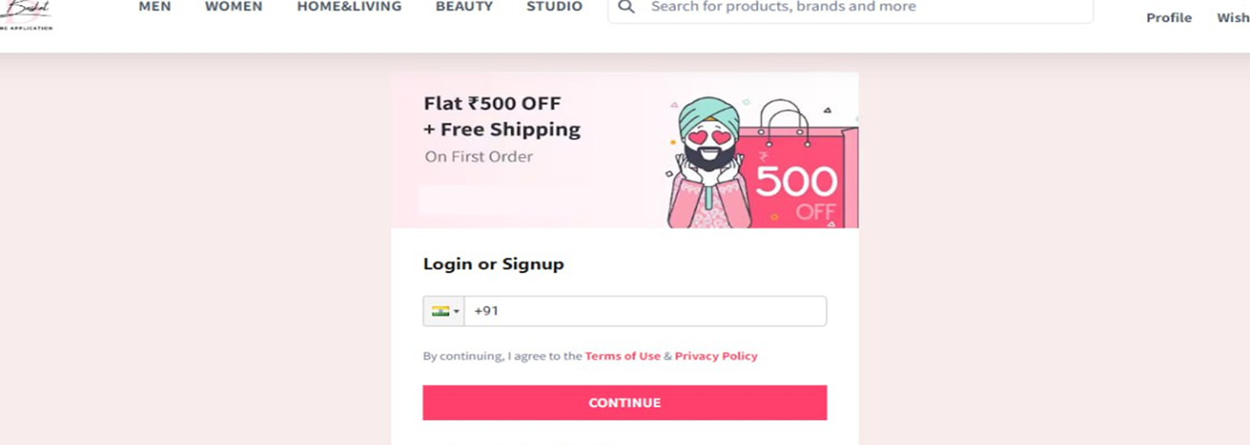
Login and sign up page

Slide 7
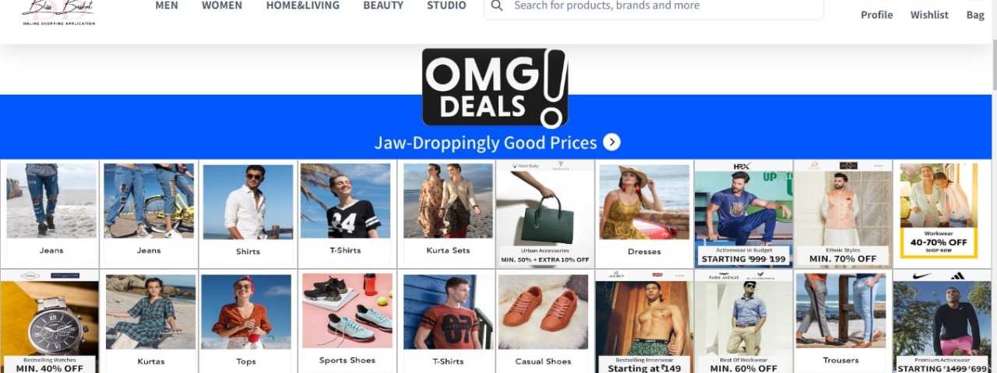
Home page

Slide 8
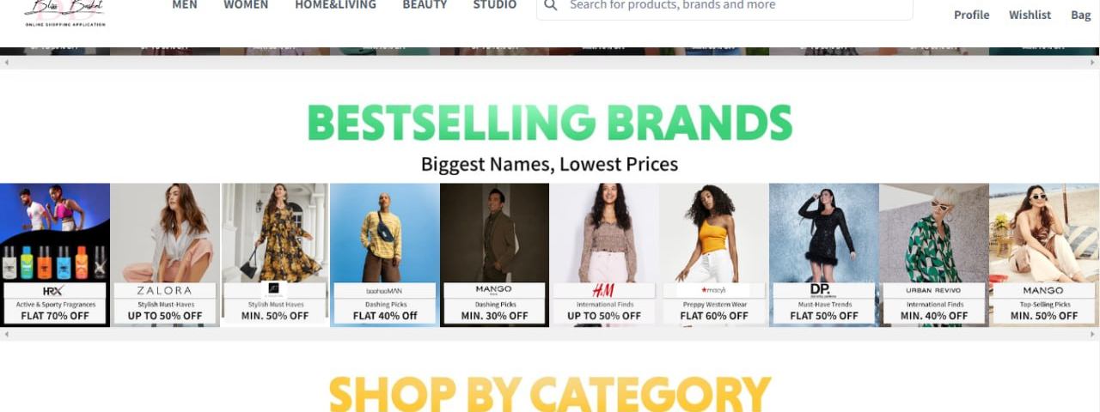
Category selection page

Slide 9
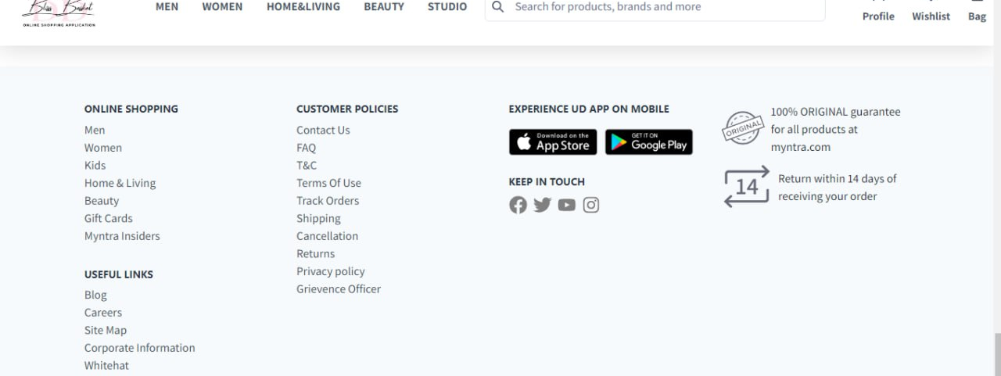
footer

Slide 10
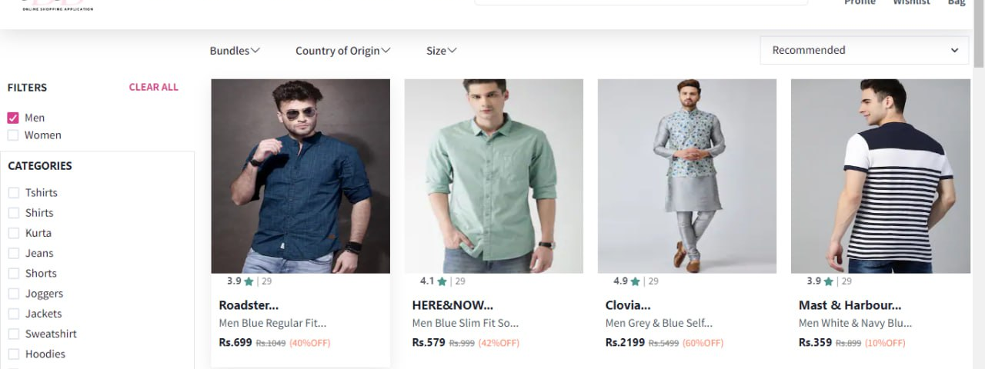
Category items

Slide 11
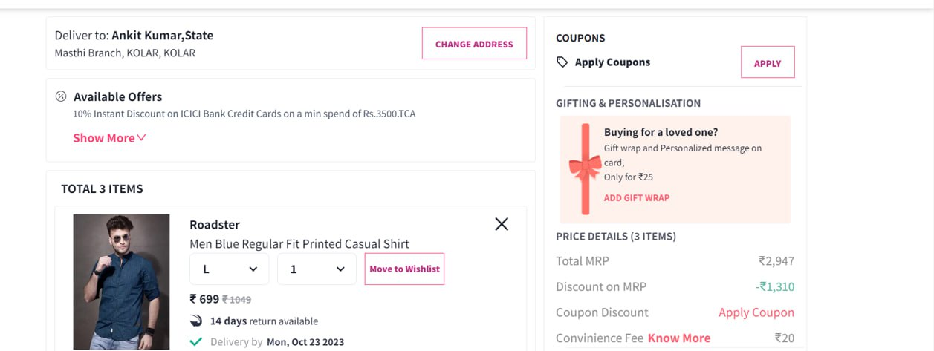
Adding to cart

Slide 12
Thankyou

